Slide 1
Auto Insurance Analysis
Radha Avudaiappan, Abby Bilger, Dustin Fife
Notes:
Welcome to capstone presentation, we would like to thank for viewing our presentation as well as tom and sarah for being very supportive instructors these 11 weeks of training

Slide 2

Purpose of the Project
Analyze the factors that affect auto insurance rates including crash statistics, population traits, and socioeconomic factors
Research and model data from a multiple data sources including the Census data
Implement machine learning and statistical analysis tools such as pandas (Python) and Power BI
Notes:
Radha
-use the skills we used in our training

Slide 3

Exploratory Questions and Data Sources
Questions
What are the causes of car crashes?
Which states have the most accidents?
Which states have the highest/lowest insurance premiums?
Can we accurately predict the price of a car insurance claim?
Can we accurately predict whether a claim will be rejected?
Data Sources
Census Data Portal
Insurance Information Institute
National Highway Traffic Safety Administration
Emcien Patterns Knowledge database
Notes:
Radha
-as an overview of our project
-show case our skills (power bi, python, and etl) that we learned through training to analyze the different factors that affect auto insurance.
-1 start off by analyzeing car crashes -since that is a major reason why claims are filed
-machine learning regression and classification models to predict the price of an insurance claim as well as whether or not a claim will be rejected
-census

Slide 4
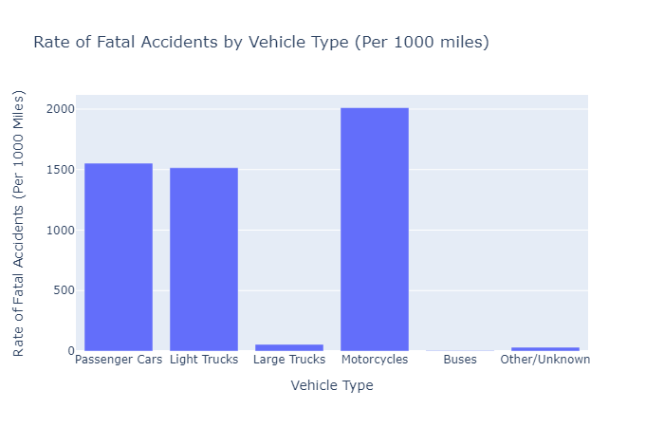
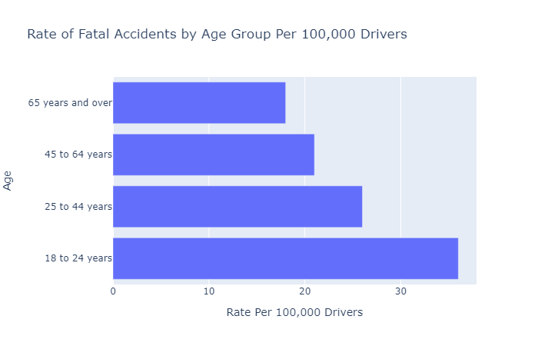
Types of Vehicles and Age Breakdown -Crash Analysis
Motorcycles are most likely to be involved in a fatal accident
Younger drivers tend to be involved in more accidents
Notes:
Radha
*start off our crash analysis presentation by analyzing fatal car crashes,we’ll go into how that may or may not have helped us.
-start off analyzeing to

Slide 5
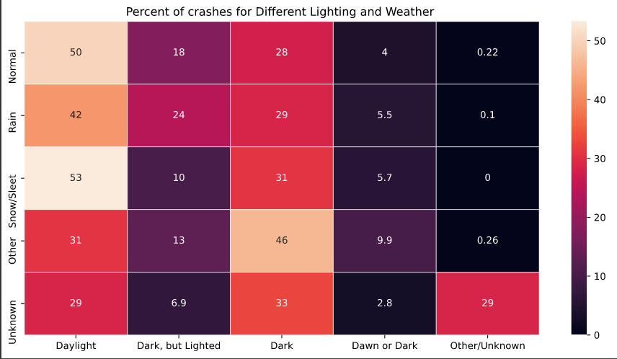
Weather vs. Daylight-Crash Analysis
Notes:
Radha
-next we looked into how weather/daylight
-icy conditions-slippery roads, also block visibility

Slide 6
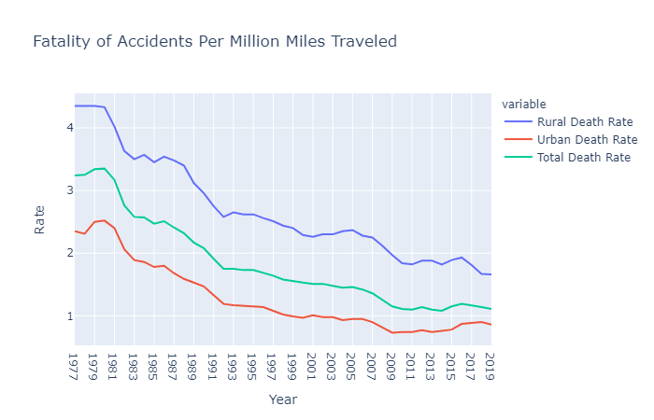
Urban vs. Rural-Crash Analysis
Possible causes:
Rural roads have higher speed limits
Roads tend to be in poorer condition
Less likely to be plowed during winter time
Note: Only fatal accidents were analyzed.
Rural roads consistently have higher fatal collision rates
Notes:
Radha
-this wasnt our prediction
-urban areas with high density
-fatal limit crashes limits our data, in that most urban crashes might not be fatal since they are driving at shorters speeds
-types of accidents you might see are rear ends and sideswipes that might not be the most deadly

Slide 7
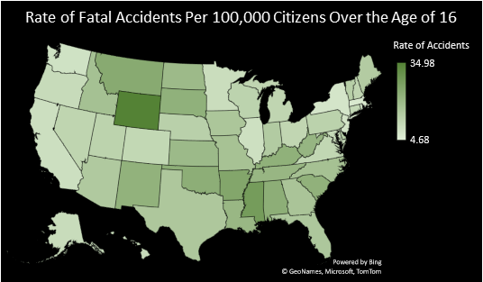
Breakdown of States-Crash Analysis
3 States with Highest Fatal Collision Rate:
Wyoming
Mississippi
Arkansas
3 States with Lowest Fatal Collision Rate:
Washington D.C
Massachusetts
New York
Rural states tend to have higher collision rates
Notes:
Radha

Slide 8
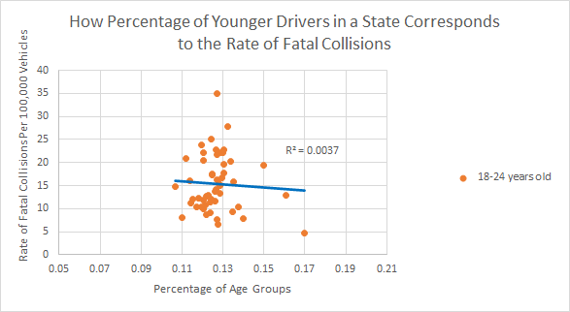
How Big of A Factor is Age in Predicting a Fatal Accident?
Although younger drivers are more likely to get into a fatal accident, areas with more younger people do not necessarily have higher accident rates
Notes:
Radha

Slide 9
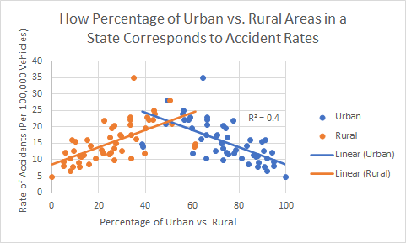
How Big of a Factor is Urban/Rural Distribution in Predicting Fatal Crashes?
With a moderate correlation of 0.4, rural or urban location should be considered in predicting fatal crashes in an area.
Notes:
Radha

Slide 10
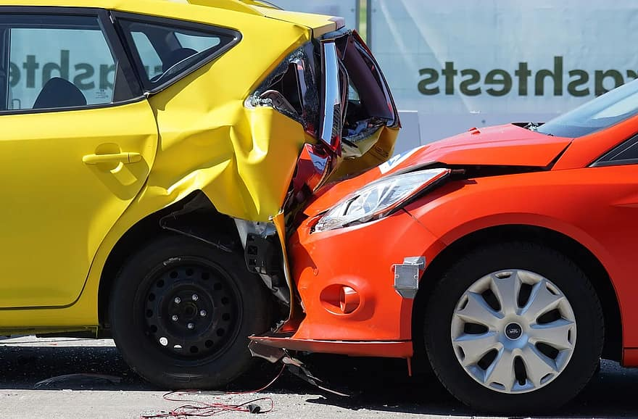
Other Factors Worth Considering: Crash Analysis
Make and model of vehicles
Analyzing all crashes not just fatal crashes
Deeper analysis on different factors that affect different climates
Quality of Drivers’ Education in each state
State/City Ordinances (i.e. speed limits, laws that limit driving due to alcohol and curfews)
Notes:
Radha
End our crash analysis portion

Slide 11
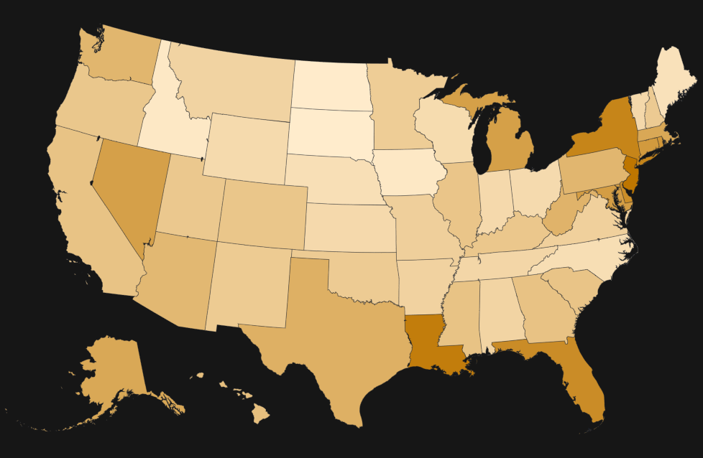
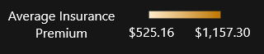
Average Insurance Premium By State (2010)
Highest Premiums:
• New Jersey: $1,157.30
• Washington DC: $1,133.87
• Louisiana: $1,121.46
Lowest Premiums:
• South Dakota: $525.16
• North Dakota: $528.81
• Iowa: $546.59

Slide 12
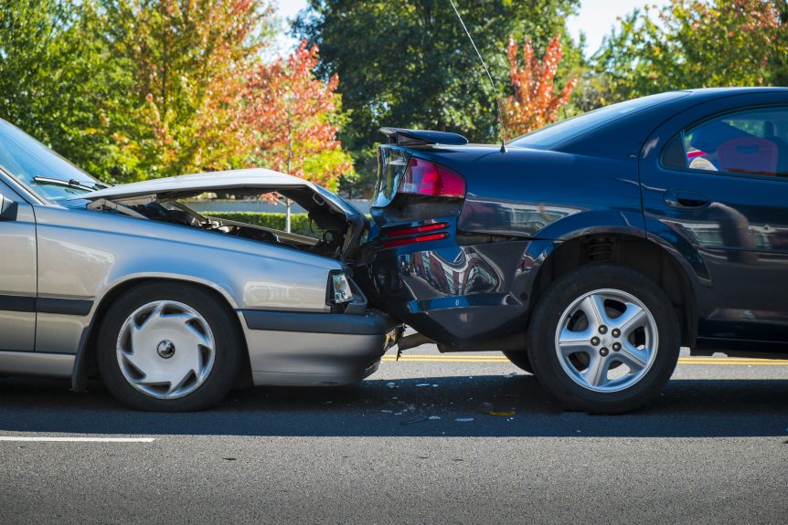
Factors that Affect Insurance Premiums
Driving habits (Claim history, driving record, how much you drive, etc.)
Vehicle Type
Location
Age and Gender
Income and Credit History
Information on Insurance Premium Factors taken from Allstate and Insure

Slide 13
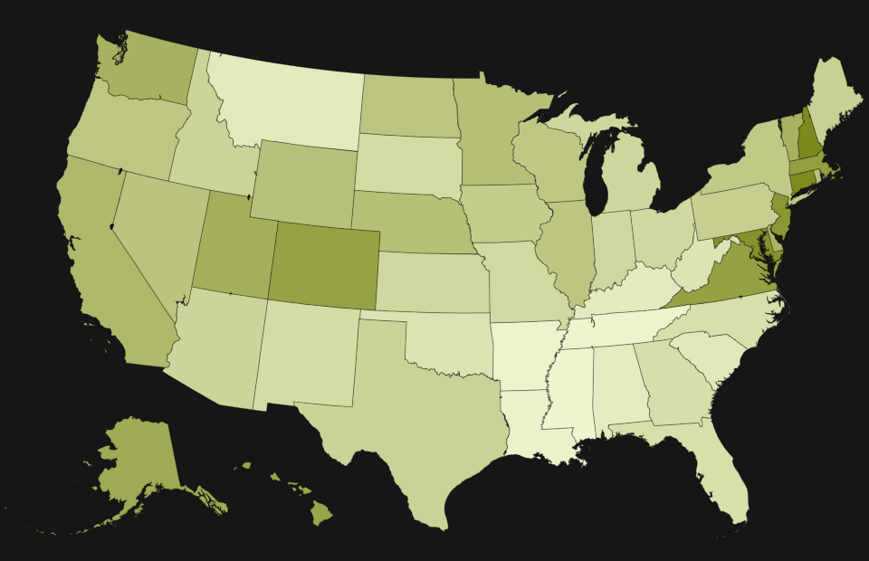
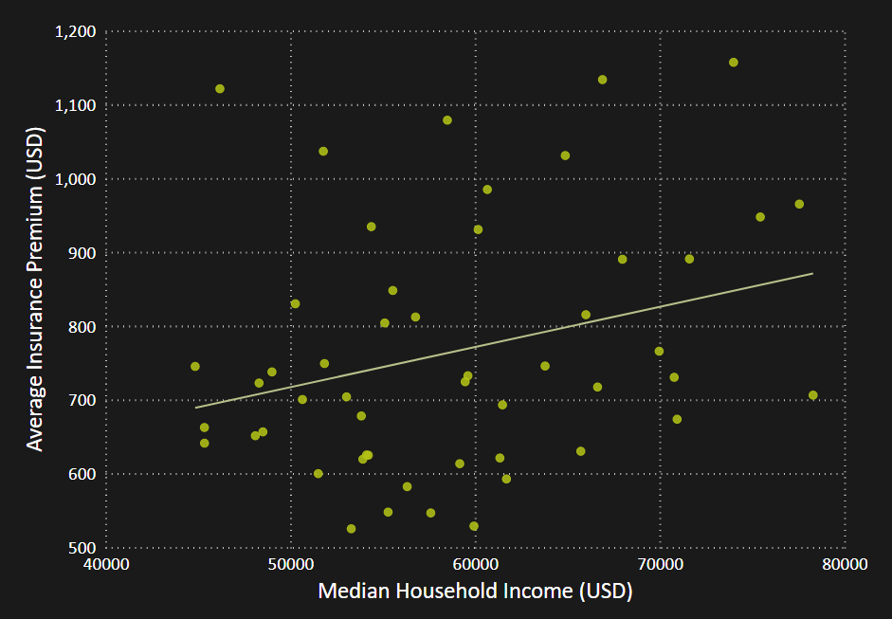

Median Household Income
Median Household Income by State (2010)
Insurance Premiums by Median Income
The correlation between median income and insurance premiums at the state level was 0.268.

Slide 14
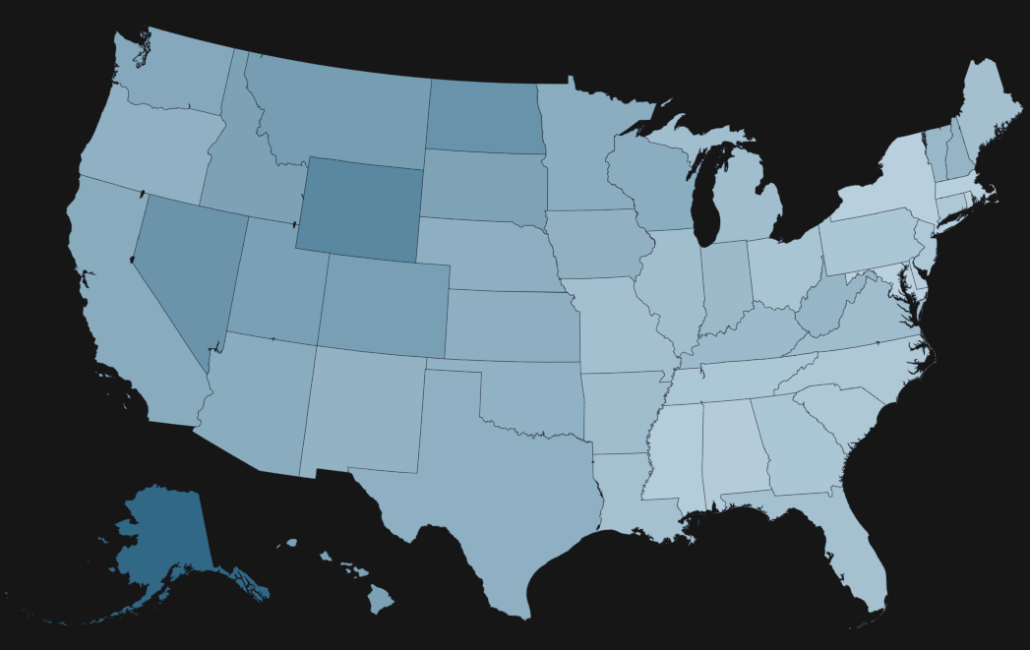
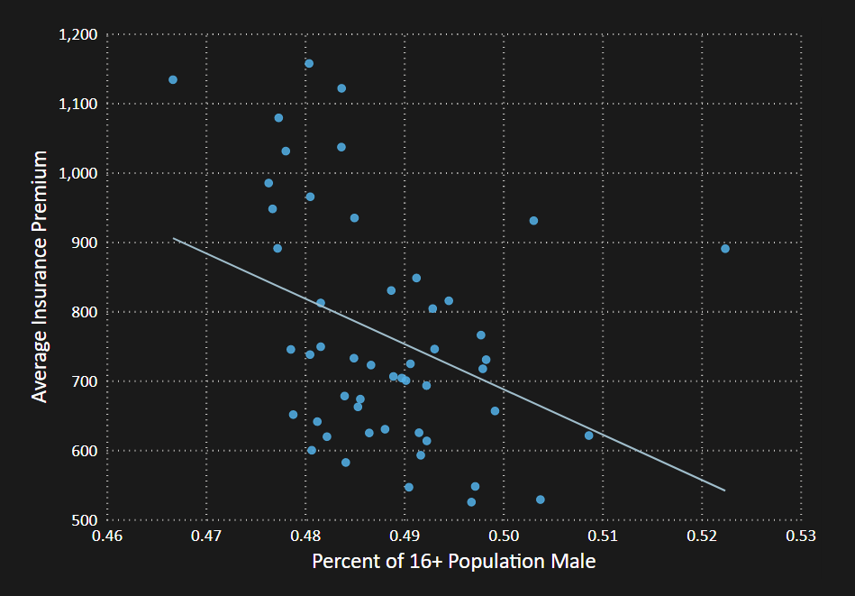
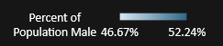
Gender Distribution
Percentage of 16+ Population Male (2010)
Insurance Premiums by Percent Male
The correlation between median income and percentage male at the state level was -0.372.

Slide 15
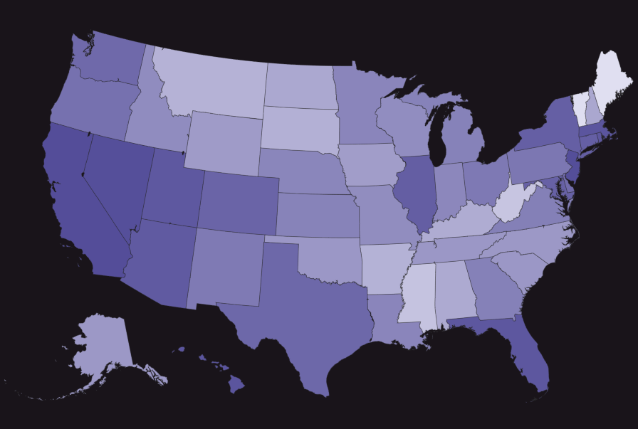
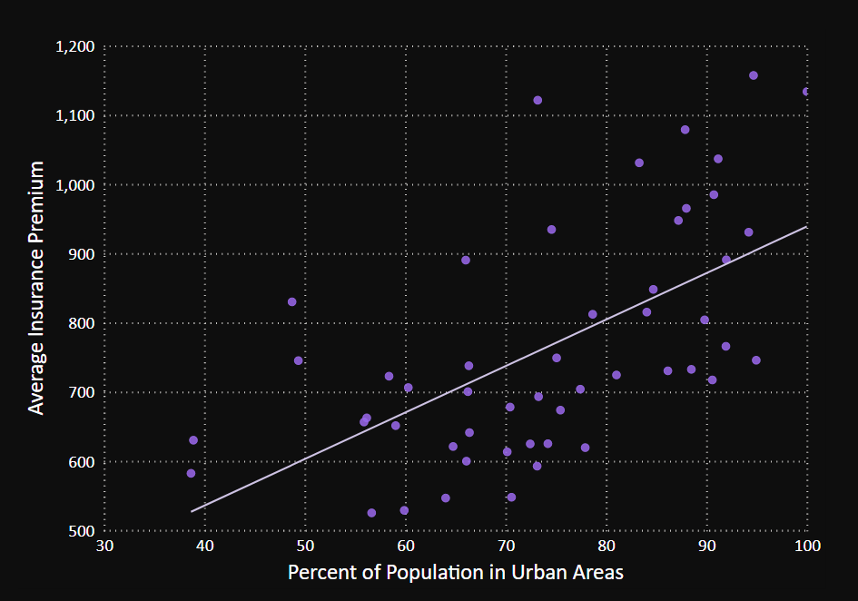
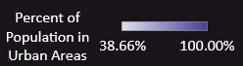
Urban Percentage
Urban Population Percentage by State (2010)
Insurance Premiums by Median Income
The correlation between urban percentage and insurance premiums at the state level was 0.598.
Notes:
Urban area is defined as 2,500 or more people

Slide 16
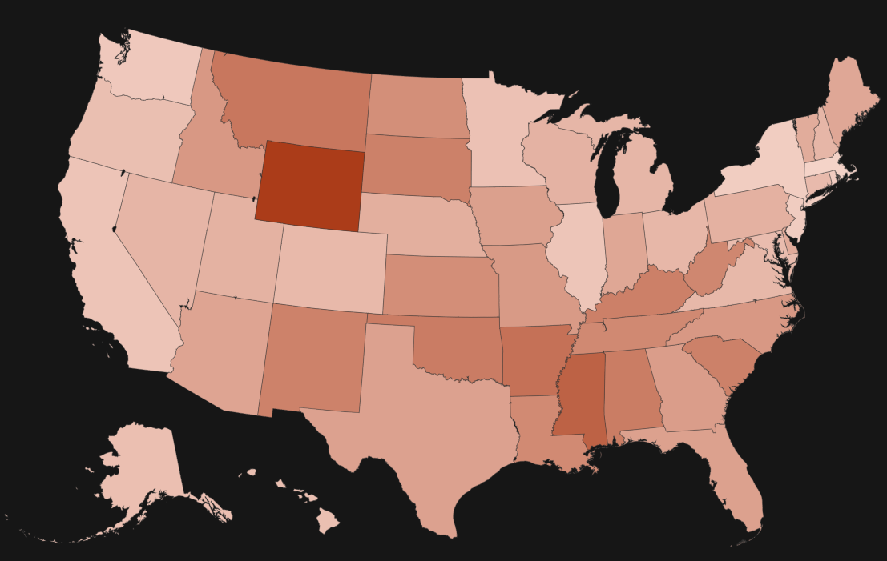
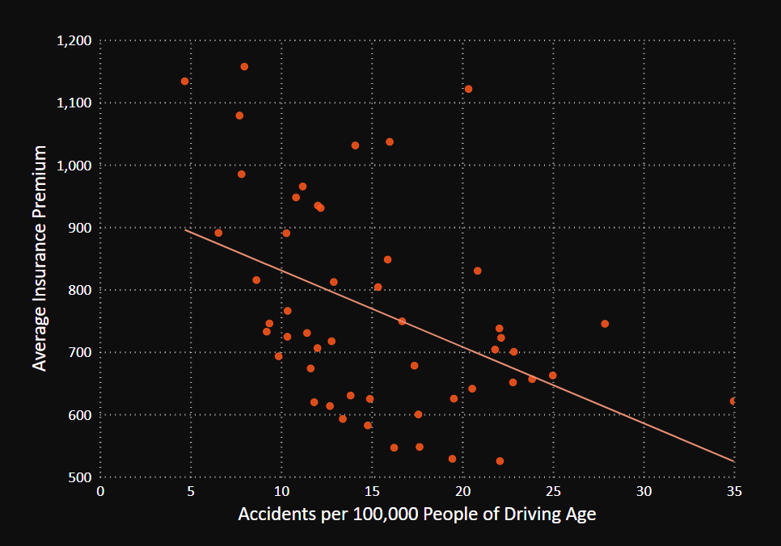
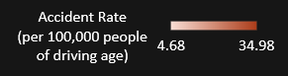
Accident Rate
Accident Rate by State (2010)
Insurance Premiums by Median Income
The correlation between median income and insurance premiums at the state level was -0.446.

Slide 17

Statewide Data Analysis Summary
Insurance premiums are highly personalized, Census data is not
Some relationships were unexpected (Accident Rate)
Some expected relationships were not found (Income)
A lot of data on important factors was unavailable
Need data on more factors
May not be possible to effectively predict statewide

Slide 18

Machine Learning: Auto Insurance Claims
Goals:
Predict the cost of a claim
Predict whether the claim is accepted or denied.
Both Regression and Classification models used
Cross Validation with training and testing datasets

Slide 19
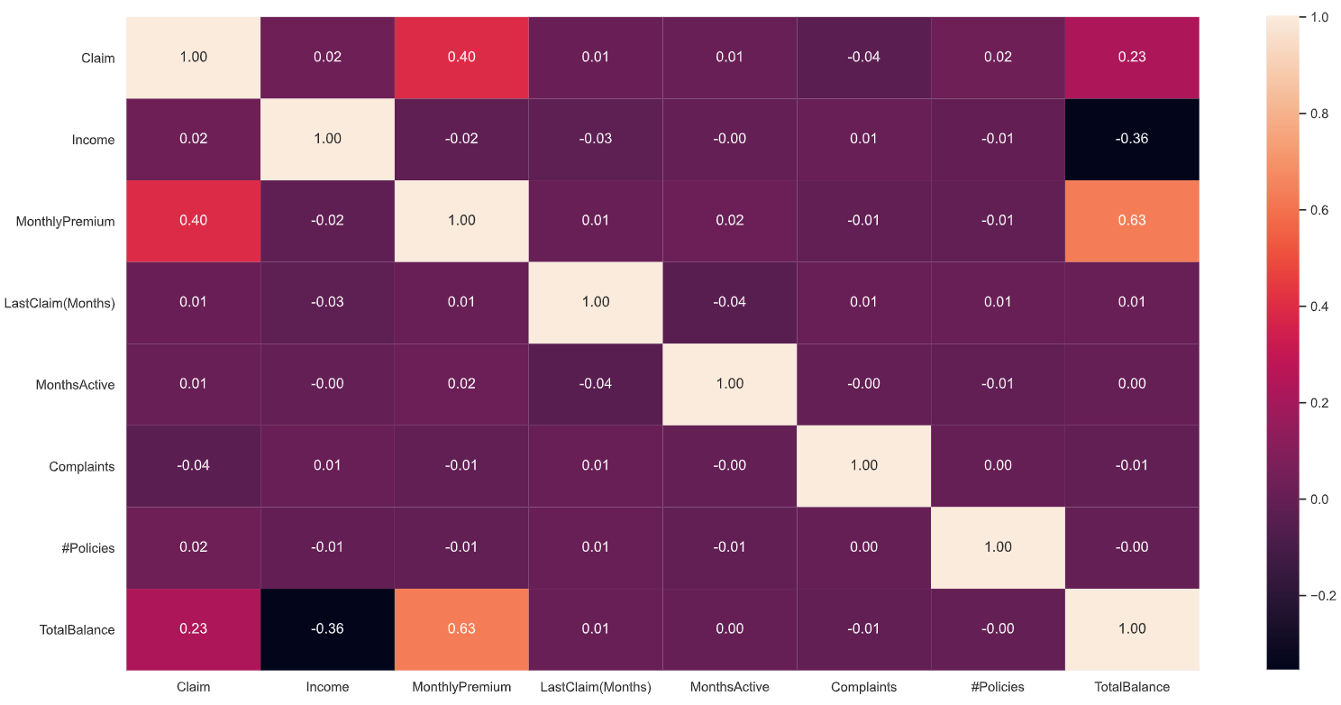
Claims Correlation
Notes:
- Only meaningful correlation for Claim is with Monthly Premium.

Slide 20
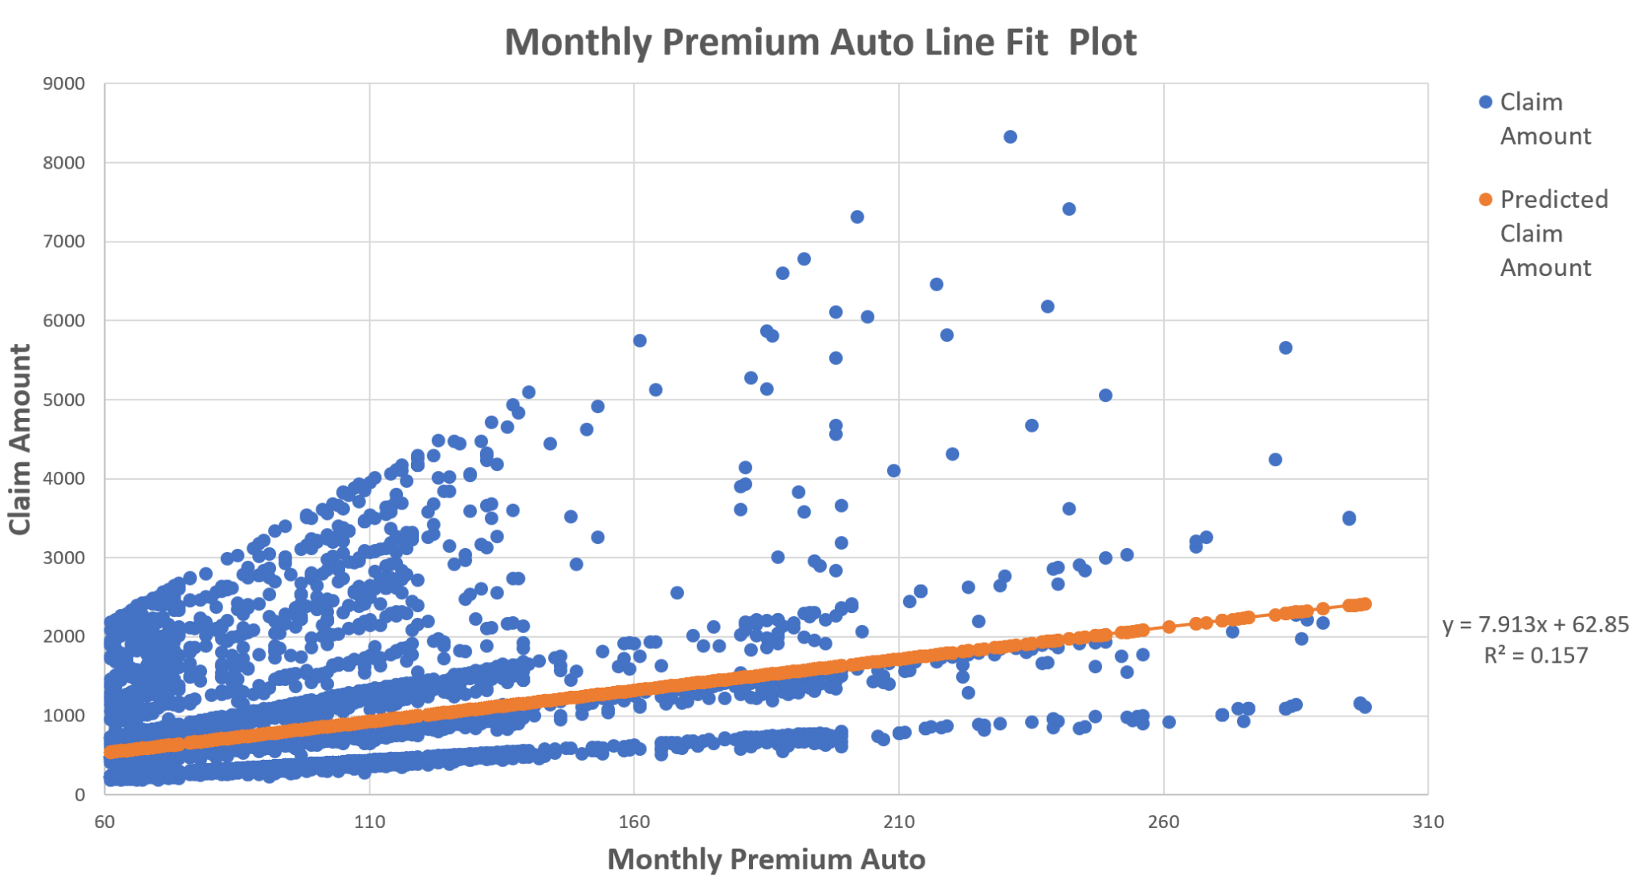
Linear Regression Model
Multivariate Regression Accuracy: 0.28
Monthly Premium is the most impactful predictor

Slide 21
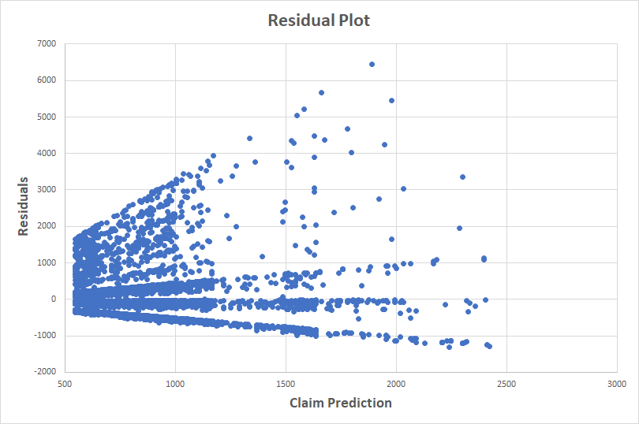
Residuals
Not very effective for predicting claim values.
Multivariate regression only produced slightly better results
Need more data to be able to predict this
Value of vehicle
Severity of damage

Slide 22
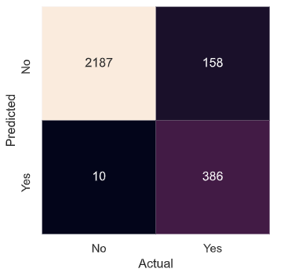
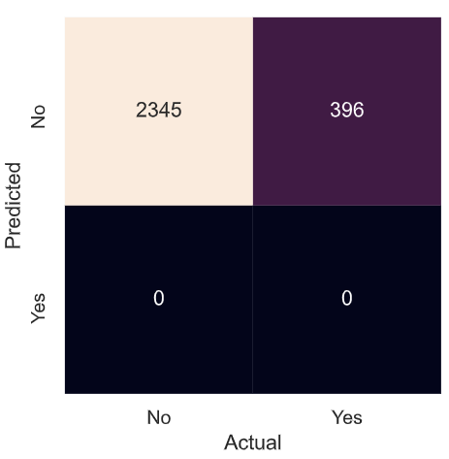
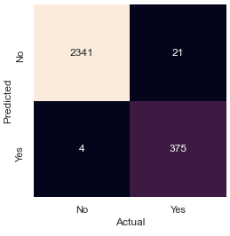
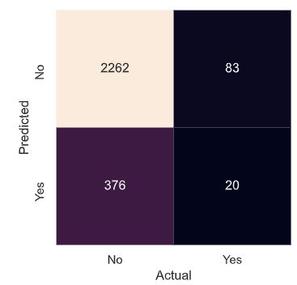
Classification Models: Confusion Matrices
Performance of Algorithms:
K-Nearest Neighbor: 0.94 Accuracy
Naive Bayes: 0.86 Accuracy
Random Forest: 0.98 Accuracy
SVM: 0.83 Accuracy
For our final classification algorithm, we used Random Forest.
K-Nearest Neighbor
Naive Bayes
Random Forest
SVM

Slide 23
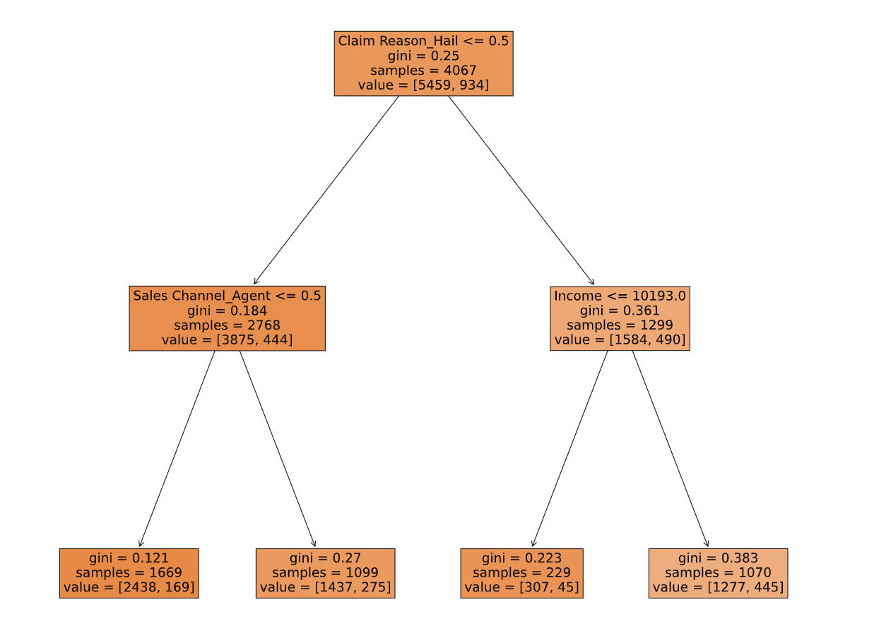
Classification: Random Forest
Very effective for predicting if Claim will be accepted or denied.
Most important factors
Claim Reason Hail
Sales Channel Agent
Income

Slide 24

Limitations
Only had access to Fatal Crash Data and overarching data for important factors such as weather and types of vehicles
Machine Learning data was oriented to Classification
Census data is aggregated across a large population but auto insurance is personalized for each customer
We did not have access to any data on many of the most important factors
Notes:
To wrap up

Slide 25
Summary of Findings
Factors that cause fatal crashes:
Younger Drivers, Snowy/Icy Weather Conditions, Motorcycles
Rural roads cause more fatal accidents than urban roads and play as an important factor for predicting them.
On a state level, there were no strong correlations between demographic data and insurance premiums. Only a few factors, such as Urban Population Percentage, showed meaningful correlation.
Some of the trends on a state level contradicted expectations
Negative correlation between Insurance Premiums and Male Population Percentage
Negative correlation between Insurance Premiums and Accident Rate
Our machine learning data was ineffective for predicting claim cost, however was more than adequate for predicting whether a claim would be accepted or denied.

Slide 26
Summary of Findings
We were able to find a few factors in our data that were useful in predicting car accidents and insurance premiums on a state or national level
Machine learning performed well for classification, but was missing important factors for regression.
Future work should focus on identifying data for a wider range of factors and incorporating that data to make better predictions.

Slide 27
Thank you for listening!
Questions?

